Slide 1
Fox Fox Foo The program for project groups
Lizzy Jamie
Jay Shoumaker
Joseph Tate
Notes:
Lizzy

Slide 2



Project analysis slide 2
The Engineering Design Process
Identify Problem
Refine
Test
PROJECT
Identify Constraints
Build Prototype ..
Generate Solutions
Plan & Schedule
Evaluate Solutions
Notes:
Lizzy

Slide 3
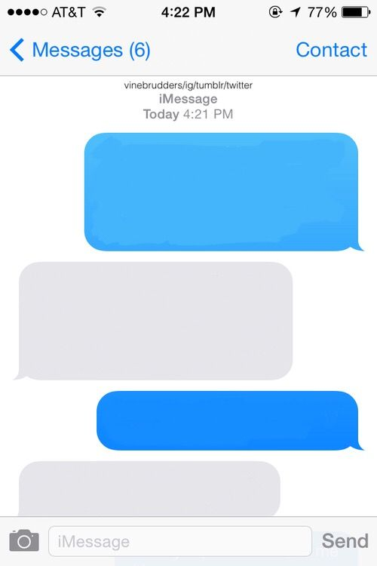
Project analysis slide 3
Identify Problem
Where should we meet to work on our project?
Idk. I don’t want to walk too far
Sample, Faythe. “Blank Image.” PicsArt, 29 July 2017, cdn140.picsart.com/239043789057202.jpg? r1024x1024.
How about Bizzell?
No, I’m in Sarkey’s
Notes:
Lizzy

Slide 4

Project analysis slide 3
Identify Constraints
Deadline: December 2, 2019
Resolve all errors
Program runtime efficiency
Limited presentation space
“Deadline.” 10 Essential Tips To Meeting Deadlines, 7 May 2017, thepitcher.org/10-essential-tips-to-meeting-deadlines/
Notes:
Lizzy

Slide 5
Project analysis slide 3
Generate Solutions
Java code
Maps API – Google Maps API, HERE Maps API
JavaX – GUI applications
Variables – number of group members, method of travel, current locations, preferred places to meet, carpooling
Outputs picture of map
Notes:
Joseph

Slide 6
Project analysis slide 3
Evaluate Solutions
GitHub
Free Maps API – N/A
Time does not allow for:
Input method of travel
Input list of preferred places to meet
Carpooling
Output picture of map
Notes:
Joseph

Slide 7
Project analysis slide 3
Plan & Scheduling
Mondays during Freshman Engineering Experience class
Thursdays at 7:00pm in Bizzell
GitHub – online collaboration
Notes:
Joseph

Slide 8
Project analysis slide 3
Build Prototype
3 classes and a ReadMe file
ReadMe – detailing steps of the engineering design process
Map.java – Create campus locations and brainstorm center point calculator
MapDisplay.java – Creating the initial menu box
Main.java – Create map object
Notes:
Jay: “So for this project, we decided to create three different classes that the program will use as well as a README file that also documents our engineering design process. Map.java would be the file that generates each of the major buildings on campus and performs the calculations for finding the center point, MapDisplay.java would be the file that creates the display box that allows the program to be used, and Main.java would initialize the map object and start the program.”

Slide 9
Project analysis slide 3
Build Prototype
Map.java – Finish coordinate locations of major buildings and complete center point functionality
MapDisplay.java – Finish menu box
Main.java – No changes since
Notes:
Jay: “At the end of our prototype’s construction, we successfully managed to have Map.java find the center point location as well as the next two best locations and finished the GUI box within the Map Display.java file. Main.java needed no editing after the initial creation.”

Slide 10

Project analysis slide 3
Test
Open Eclipse and run the program!
“Yay Gif.” Giphy, giphy.com/gifs/rainbow-colorful- pinwheel-f7GDJs0SXg1WFXNSNQ
Notes:
https://github.com/KaiTuyt/ENGR-1411-Project
Jay: “We will now test the program by using Eclipse.”
Move to Eclipse to run Program

Slide 11
Thank You Any Questions?
Notes:
Jay

Slide 12

Project analysis slide 3
Cited Sources
“1pgmapJune2010.Pdf.” OU Parking Services, June 2010
“Google Maps.” Google Maps, Google, www.google.com/maps/.
User noumenal, and User AugSB.
“Finding the Centre of an Abritary Set of Points in Two Dimensions.” Mathematics Stack Exchange, Stack Overflow, 27 May 2016, math.stackexchange.com/questions/1801867/finding-the-centre-of-an-abritary-set-of-points-in-two-dimensions.
Notes:
Lizzy

Slide 13

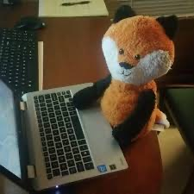
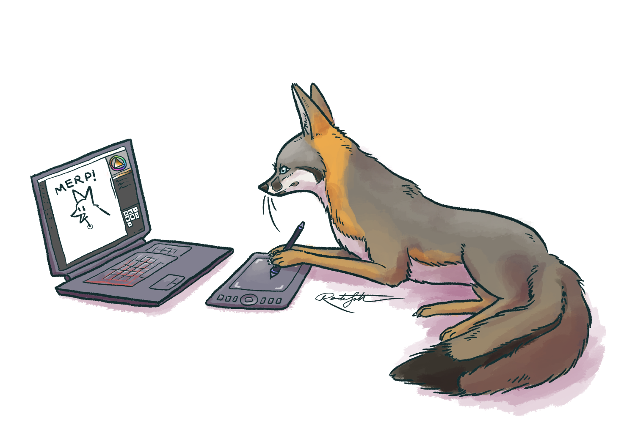
Project analysis slide 3
Fox Fox Foo
Lizzy Jamie – elizabeth.l.jamie-1@ou.edu
Jay Shoumaker – jay.w.shoumaker-1@ou.edu
Joseph Tate – joseph.a.tate-1@ou.edu
Table Space – enough to fit two laptops
Floor Space – none required
Electrical Outlet – yes (preferably two)
Each member should* be able to attend the Freshman Showcase
“Fox Pic on Twitter.” Twitter, www.google.com/imgres?imgurl=https%3A%2F%2Fpbs.twimg.com%2Fprofile_images%2F757559437443858432%2FxtCr7LF6_400x400.jpg&imgrefurl=https%3A%2F%2Ftwitter.com%2FFox_Pick%2Fstatus%2F1117183612703604769&tbnid=0qAm8Bgcm5920M&vet=12ahUKEwj26q2kuYPmAhUF36wKHZdODIUQMygKegUIARDjAQ..i&docid=xM4Z4JZFq3fhHM&w=400&h=400&itg=1&q=fox%20on%20computer&ved=2ahUKEwj26q2kuYPmAhUF36wKHZdODIUQMygKegUIARDjAQ.
Programmer Devil com- Drawception. www.google. /imgres?imgurl=https%3A%2F%2Fcdn.drawception.com%2Fdrawings%2FNACPbv0687.png&imgrefurl=https%3A%2F%2Fdrawception.com%2Fgame%2FfCGLG29xwF%2Fprogrammer-devil%2F&tbnid=WAREVz4-YO1DgM&vet=12ahUKEwj26q2kuYPmAhUF36wKHZdODIUQMygQegUIARDvAQ..i&docid=oxFIY45kHD54KM&w=300&h=250&q=fox%20on%20computer&ved=2ahUKEwj26q2kuYPmAhUF36wKHZdODIUQMygQegUIARDvAQ.
Confused Fox - The Vulpine Club. www.google.com/imgres?imgurl=https%3A%2F%2Fassets.vulpine.club%2Fmedia_attachments%2Ffiles%2F002%2F322%2F012%2Foriginal%2Fad350dee03bb3fe2.png&imgrefurl=https%3A%2F%2Fvulpine.club%2F%40jafx&tbnid=U7MIFc1ZBnyRgM&vet=12ahUKEwj26q2kuYPmAhUF36wKHZdODIUQMygLegUIARDlAQ..i&docid=eMN0_gR0OAsxQM&w=1500&h=1000&q=fox%20on%20computer&ved=2ahUKEwj26q2kuYPmAhUF36wKHZdODIUQMygLegUIARDlAQ.
Notes:
Lizzy – 100% free
Jay – Free between 12:30 - 1:20pm
Joseph - unknown

Slide 14
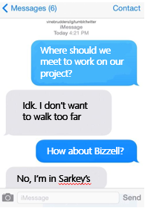
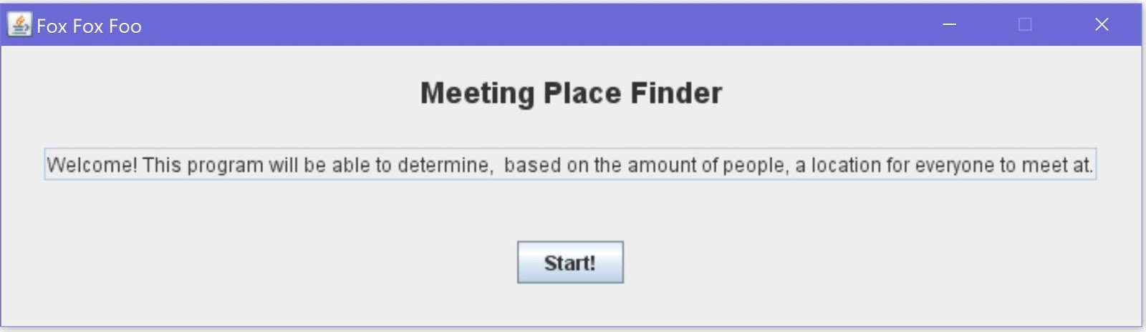
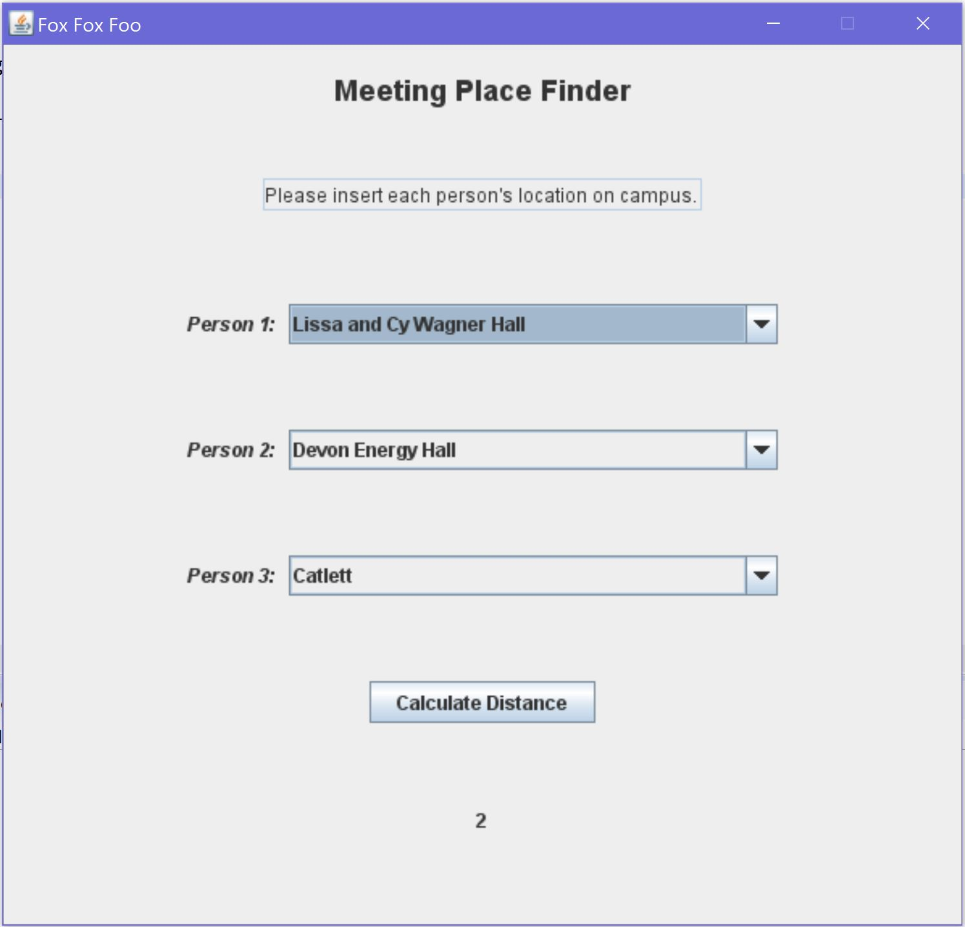
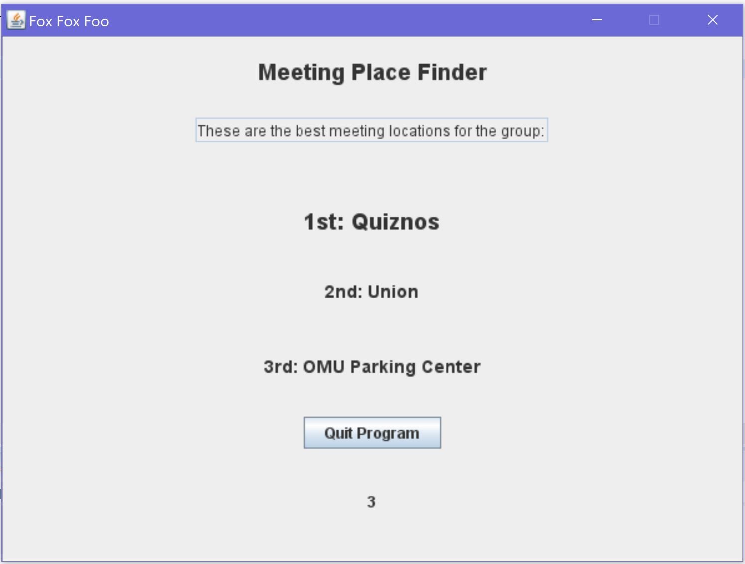
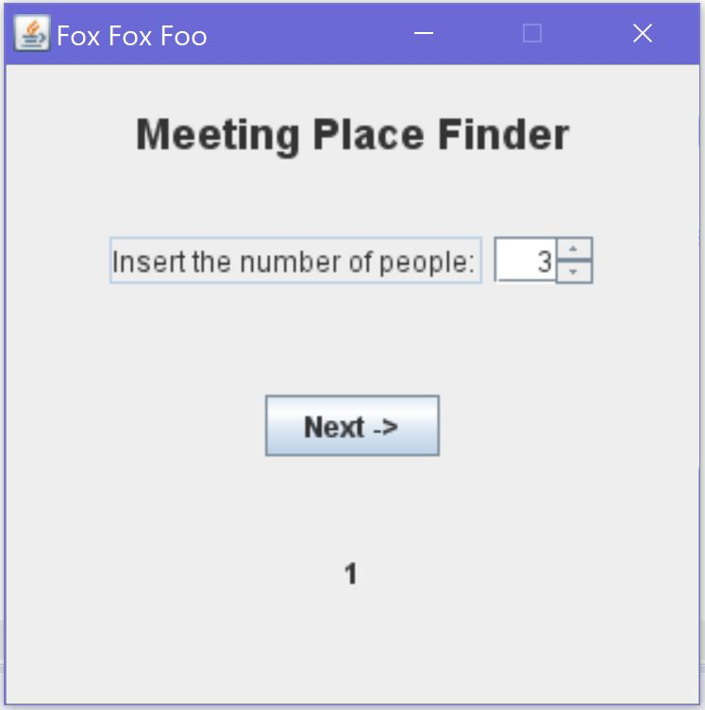
Fox Fox Foo
The program for project groups
Identify Problem
Identify Constraints
Generate Solutions
Evaluate Solutions
Build Prototype
- GitHub
- Free Maps API – N/A
- Time does not allow for:
- Input method of travel
- Input list of preferred places to meet
- Carpooling
- Output picture of map
Plan & Schedule
- Map.java – Finish coordinate locations of major buildings and complete center point functionality
- MapDisplay.java – Finish menu box
- Main.java – No changes since
- Deadline: December 2, 2019
- Resolve all errors
- Program runtime efficiency
- Limited presentation space
- Java code
- Maps API – Google Maps API, HERE Maps API
- JavaX – GUI applications
- Variables – number of group members, method of travel, current locations, preferred places to meet, carpooling
-Outputs picture of map
- Mondays during Freshman Engineering Experience class
- Thursdays at 7:00pm in Bizzell
- GitHub – online collaboration
Test

